Slide 1


Machine Learning Practitioner Stakeholder Playbook

Slide 2



Introduction
Welcome
Welcome to the Machine Learning Practitioner program!
This program has been developed to provide our software engineers and technical leaders with a flexible, interactive, and self-directed learning experience to improve their knowledge of machine learning.
The purpose of this Playbook is to provide an in-depth overview of the program and its various components.

Slide 3

About the Program
The Machine Learning Practitioner program is a flexible, self directed, interactive learning journey that includes self-paced content, on-the-job and peer learning, structured support, cross-team collaboration, and individual actions plans to align learning outcomes with business goals and strategies.
Purpose
Accelerate ramp-up time of software engineers and technical leaders to become familiar with machine learning
Improve the proficiency of our software engineers and technical leadership in machine learning
Deepen understanding of analytical and machine learning concepts
Foster data-driven decision making using machine learning
Promote cross-team collaboration
Goals
Deliver a Superior Experience: Create a structured, consistent, and positive learning experience
Expand Understanding: Improve foundational knowledge about machine learning
Drive Clarity: Improve view of Comcast Tools: get a glimpse into how we solve problems using machine learning at Comcast
Foster Critical Thinking: Quickly provide software engineers and technical leaders with the knowledge and tools to make informed decisions and think critically using data
Increase Cross-Team Collaboration: Promote cross-team communication and information sharing

Slide 4
About the Program
Self-directed learning journey
8 weeks long
Learner-driven progression
46 hours of structured learning activities
Relies on help from support roles (see roles and responsibilities section for more info)
Software Engineers/Leaders
Peer Assisted Learners (PAL)
Subject Matter Experts (SMEs)
Comcast University
Flexible
Asynchronous delivery model supports dynamic hiring patterns and dispersed geographies
Program schedule and activities can be adapted to meet changing business needs
Learning Journey Portal
Provides user interface for participants to interact with program content and activities
Provides tool for program administration
Content Delivery
Web Based Training
Videos

Slide 5

Program Structure
Self-directed progression
Self-paced, interactive content
Experiential learning activities
Review and action planning activities
Cross-team collaboration
Knowledge checks
PAL review and feedback sessions
Manager connections

Slide 6


The Learning Journey
The Experience
Machine Learning Practitioner program is considered a self-directed learning program. The learner is required to complete 46 hours of training over a 8 week time frame.
Learn – 32 total hrs.
Self-directed learning modules
Welcome and Introduction Activities
Customized and tailored learning plans from a variety of (WBT)
Explore and Apply – 9 total hrs.
Experiential Learning
Structured activities with PAL/peers
Structured cross-team collaboration
Review – 2 total hrs.
Confirmation of Learning
Self-directed knowledge checks
PAL review and feedback
Plan – 1 total hrs.
Goal setting and action planning
Develop opportunities
Leverage strengths
An Immersive Learning Journey
Learning journey portal
Welcome video
Web Based Training
Structured connections
Experiential learning activities
Social collaboration and learning
Manager Connection – 1 total hr.
Structured touchpoints
Progress updates and Q&A
Discuss Review & Plan outcomes

Slide 7
Machine Learning Practitioner Program Concepts
Throughout the learning journey participants will be presented with Machine Learning Practitioner concepts that provide generalized knowledge for a foundational understanding of Comcast’s machine learning practices. These core concepts (noted below, left) form the primary technical training topics covered in the program. For each of the core topics, the program will guide participants through structured learning experiences (noted below, right). Because these core concepts are a critical foundation for a software engineer or technical leader, course materials will be regularly reviewed and updated to ensure that even our newest engineers have the most up-to-date information at their fingertips.
60 Min. or More
Machine Learning Practitioner Program
Google Developer Machine Learning Crash Course
ML Concepts
ML Engineering
ML Examples
Data Prep
Custom Course for Comcast Data Prep
Google Data Prep Course
Assessment of learned skills via labs
Learn
Plan
ML Practitioner Program Concepts
Explore & Apply
20 Min.
1-2 Hrs.
Review
Experiential
Learning
Activities
30 Min.
Self-directed activities
PAL-assisted activities

Slide 8
Participant Timeline
Oct 29
Kickoff/Orientation
Oct 29 - Nov 23
Google ML Crash Course Concepts
Nov 19 - Nov 23
Fairness, Accountability and Transparency in ML and select readings
1 day
20 days
Nov 26 - Nov 30
Google ML Crash Course Framing Lab, Machine Learning Best Practices and select readings
5 days
Dec 3 - Dec 7
Google ML Crash Course Data Prep and Data Prep at Comcast
5 days
Data at Comcast, Jupyter Notebooks, reading academic papers and Lab Assessment of Learned Skills
5 days
Dec 10 - Dec 14
5 days
Dec 17 - Dec 21
Lab Assessment of Learned Skills (Continued)
2018
5 days
Oct
Nov
Dec
2018
Today
2018

Slide 9
Participant Timeline
 | Date Range | Topic | Modules | Total Time
Week 1 | 10/29/18-11/2/18 | Kickoff | Virtual orientation meeting with participants | 1hr
 |  | Google Machine Learning Crash Course | ML Concepts: Framing - Validation | 4hrs
Week 2 | 11/5/18-11/9/18 | Google Machine Learning Crash Course | ML Concepts: Representation – Classification | 4hrs 45min
Week 3 | 11/12/18-11/16/18 | Google Machine Learning Crash Course | ML Concepts: Regularization: Sparsity - Embeddings | 4hrs 25min
Week 4 | 11/19/18-11/23/18 | Google Machine Learning Crash Course | ML Engineering: Production ML Systems - Fairness | 1 hrs 30min
 |  | The importance of Fairness, Accountability and Transparency (FAT) in Machine Learning | The importance of Fairness, Accountability and Transparency (FAT) in Machine Learning | 15min
 |  | The Seen and Unseen Factors Influencing Knowledge in ML System | The Seen and Unseen Factors Influencing Knowledge in ML System | 47min
 |  | When Data Science Destabilizes Democracy and Facilitates Genocide | When Data Science Destabilizes Democracy and Facilitates Genocide | 15 min
 |  |  | Manager Check-In | 30min
Week 5 | 11/26/18-11/30/18 | Google Machine Learning Crash Course | ML Real World Examples: Cancer Prediction-Real World Guidelines | 12 min
 |  | Google Machine Learning Problem Framing | Machine Learning Problem Framing | 1 hr
 |  | Designing Great Data Products | Designing great data products | 30min
 |  | Rules of Machine Learning: Best Practices for ML Engineering | Rules of Machine Learning: Best Practices for ML Engineering | 1 hr
 |  | Machine Learning Yearning | Machine Learning Yearning | 2 hrs
 |  | Machine Learning: The High Interest Credit Card of Technical Debt | Machine Learning: The High-Interest Credit Card of Technical Debt | 45min
Week 6 | 12/3/18-12/7/18 | Google Machine Learning Data Prep | Machine Learning Data Prep | 2 hrs 45 min
 |  | Data Prep at Comcast | Data Prep at Comcast | 2hrs 29min
Week 7 | 12/10/18-12/14/18 | Data at Comcast | Data Ingest, Store, Transform, Ad-Hoc Analysis, Visualization, and Data Egress Using dx Platforms | 30min
 |  | Best practices for Jupyter notebooks | Best practices for Jupyter notebooks | 20min
 |  | How to Read Academic Papers without Freaking Out | How to read a machine learning paper | 10min
 |  | Assessment of learned skills via labs | Assessment of learned skills via labs | 4-5hrs
Week 8 | 12/17/18-12/21/18 | Assessment of learned skills via labs | Assessment of learned skills via labs | Extra Time, If needed
 |  |  | Manager Check-In | 30min
 |  | Web Based Training plus orientation total time | 33hrs 9min
 |  | Lab total time | 8hrs 55min
 |  | Manager Check-Ins | 1hr
 |  |  | 43hrs 4min

Slide 10
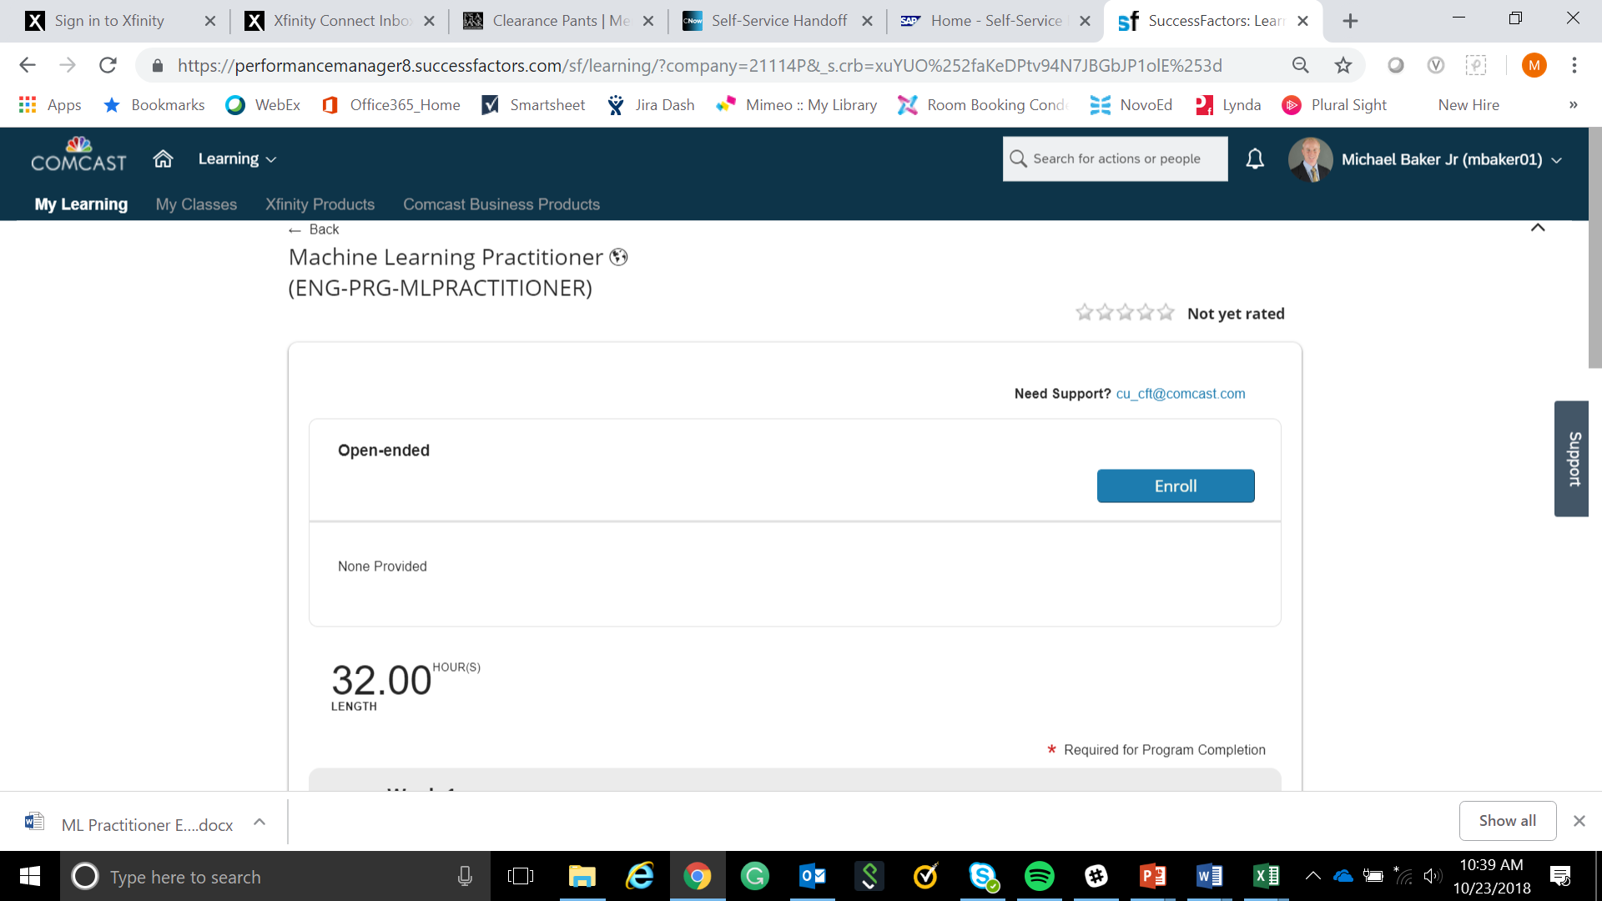
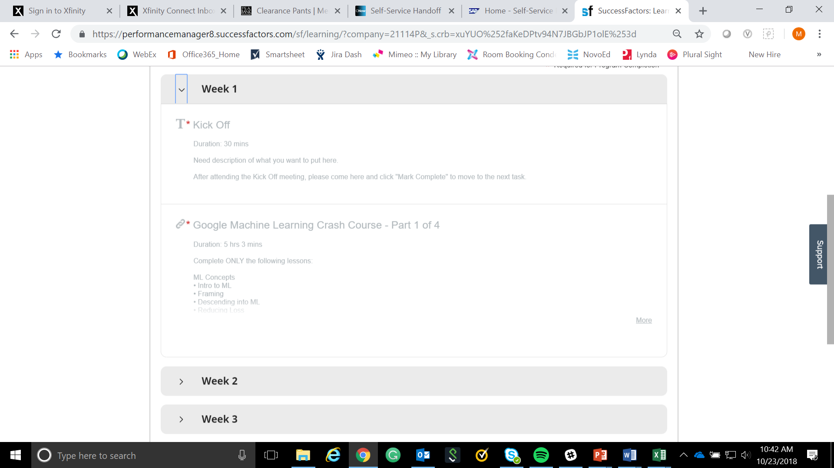

The Learning Journey Portal – myLearning
Portal
New technology platform that provides program structure and administration for engineer, manager, and PALs.
https://performancemanager8.successfactors.com/sf/learning?destUrl=https%3a%2f%2fcomcast%2eplateau%2ecom%2flearning%2fuser%2fdeeplink%5fredirect%2ejsp%3flinkId%3dPROGRAM%5fDETAILS%26programID%3dENG%2dPRG%2dMLPRACTITIONER%26fromSF%3dY&company=21114P
Self-Directed Progression
The content is divided into 8 week micro learning sections that provides an interactive and engaging learning experience. Each week the learner will complete the self paced content in the portal.

Slide 11
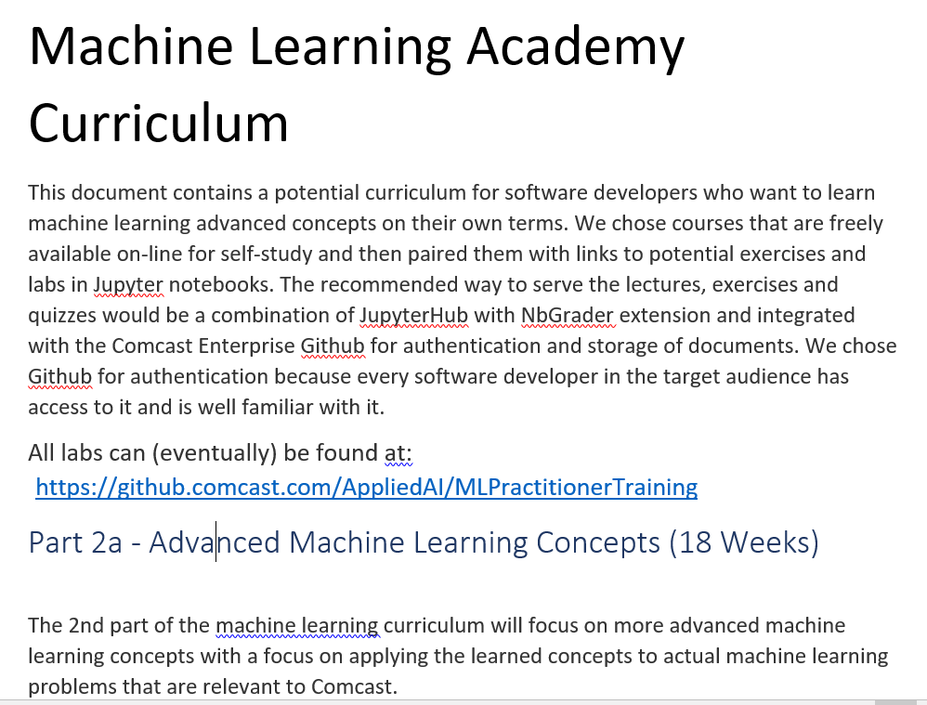
Fostering a Learning Mindset Beyond Machine Learning Practitioner
The learner’s journey doesn’t end after completion of the this program. They are encouraged to begin their next learning journey by requesting to participate in the Machine Learning Academy. This program will be ready at the conclusion of the first iteration of the Machine Learning Practitioner program. It is estimated that it will be ready in January 2019.

Slide 12

Program Roles and Responsibilities
Overview of Program Roles
Software Engineers or Technical Leaders
Manager
Peer Assisted Learner (PAL)
Subject Matter Experts (SME)
Comcast University
Expectations
The Machine Learning Practitioner program was designed as a flexible, self-directed learning journey that analysts can complete mostly on their own. However, for sustained success, the program necessitates certain roles and responsibilities.

Slide 13

Software Engineer or Technical Leader
Overview
At the center of the Machine Learning Practitioner program is the software engineer or technical leader. The goal is for them to learn and apply machine learning and make a plan of action during their learning journey.
Roles
Program Participant
Learner
Observer
Inquisitor
Critical Thinker
Practitioner
Communicator
Tasks
Complete all program activities within 8-week allotted time
Work independently during self-directed activities
Use the learning journey portal to engage with course content
Partner with PALs and SMEs to complete experiential learning activities
Expectations
Take initiative to complete program tasks in a timely manner
Communicate with manager and PAL to manage workload
Network and build professional relationships with coworkers
Think critically about program material and your role in supporting our network
Apply knowledge and skills to add value
Time Commitment
45 hours over 8-week learning journey

Slide 14

Peer Assisted Learning (PAL)
Overview
The PAL is the cornerstone of the Machine Learning Practitioner program. This person serves as the software engineer and technical leaders primary contact throughout the learning journey by leading conversations, making introductions, facilitating experiential learning activities, reviewing and applying machine learning concepts, and providing feedback via the discussion forums.
Roles
Ambassador and Role Model
Program Guide and Coach
Communicator and Facilitator
Expert Practitioner and Educator
Knowledge and Skills Evaluator
Tasks
Serve as the software engineer or technical leaders primary point-of-contact throughout learning journey
Link knowledge to practical application through Explore & Apply and Review activities
Translate Machine Learning Practitioner concepts to be specific and meaningful to each analyst/leader
Facilitate interactions between analyst and PALs, SMEs, and peers from other teams
Approve analyst activities within the learning journey portal in a timely manner
Ensure analyst is progressing through program and completes within allotted time (8 weeks)
Expectations
Be a positive role model and lead by example
Support the data science practitioner program and complete assigned tasks
Be familiar with course curriculum, materials, and activities
Communicate with analysts manager to best align support
Be available and attentive to analysts
Follow through on commitments
Provide CU with feedback on program materials and content
Time Commitment
Up to 2 hours (per week) over 8-week learning journey

Slide 15

Manager/Director/VP
Overview
A software engineer or technical leaders immediate leader also has an important part to play within the program. They will facilitate conversations with the software engineer or technical leader and support the ongoing journey for the learner.
Roles
Leader
Coach
Communicator
Program Advocate
Tasks
Actively participate in weekly touchpoint meetings
Approve analyst activities within learning portal in a timely manner
Tie learning outcomes to business goals and strategies
Assist analyst or technical leader in developing individual development plan (IDP)
Provide analyst or technical leader with relevant projects and job tasks to reinforce learning
Expectations
Champion machine learning practitioner program and ensure the software engineer or technical leader completes all assigned tasks
Manage engineer/leaders workload for full participation in learning journey
Communicate with PAL regarding engineer learning and progress
Ensure engineer/leader is progressing through program and completes within allotted time (8 weeks)
Time Commitment
1 hour total. A half hour at the mid-point and at the end of the 8-week learning journey

Slide 16

Subject Matter Experts
Overview
Subject Matter Experts (SME) are those people who have been identified as being highly proficient in a particular technical topic or functional area. SMEs are also the people who authored or approved the Machine Learning Practitioner curriculum and have excellent context regarding the technical concepts being taught. Because PALs and managers will not have expert knowledge of all core concepts, designated SMEs will be leveraged to fill any gaps and provide expertise when needed.
Roles
Expert Practitioner
Educator
Communicator
Program Advocate
Tasks
Serve as a resource for designated area of expertise
Assist engineer/leaders with practical application activities
Translate general concepts into specifics for engineer role
Assist with reviewing and updating course materials
Expectations
Champion Machine Learning Practitioner program
Be a positive role model and lead by example
Share knowledge and resources
Be available and attentive to new hires
Follow through on commitments
Time Commitment
2 hours (per week) over 8-week learning journey

Slide 17

Program Support Roles
Comcast University Program Manager
Roles
Program Administrator
Business Partner
Consultant
Communicator
Program Advocate
Tasks
Program oversight and management
Perform admin. for learning journey portal
Train PALs and managers
Help assign PAL to new hires
Manage program sustainment and updates

Slide 18

Program Implementation
Getting started
There are key action items that must occur in order for the program to run.

Slide 19

Implementation
Software engineers or technical leaders enrolled in the program must have NT login credentials, email address, and computer with Comcast Intranet access
Comcast University may need to manually enroll participants in the program
Comcast University will partner with participant leadership to assign analysts to their PAL
Communication to PALs and participants about program enrollment and start
PALs and Managers must be trained before participating in program
Commitment from leadership to provide engineers and support team with time to complete program activities
Software engineers and program support team must be held accountable for completing the program on time

Slide 20
RACI Matrix
A RACI matrix is helpful for understanding the roles and responsibilities of the various teams in sustaining the program.
Responsible
Accountable
Consulted
Informed
The RACI matrix to the right shows the type of involvement from each of the 4 key stakeholder groups:
ML Faculty = Machine Learning Faculty
CU = Comcast University
The various tasks needed to sustain the program have been grouped into four key categories:
Program Related
Learner Related
PAL Related
Manager Related
Program Related | ML Faculty | CU
Generate analyst info | R,A | C,I
Enroll analyst in program | C,I | A,R
Manage PAL pool | C,I | A,R
Assign PAL to Learner | C,I | A,R
Program Q&A | C,I | A,R
Technical issues | C,I | A,R
Content updates | C,I | A,R
Learner Related
Get started in program | R,I | A,C
ID and Communicate Concerns | C,I | A,R
Address performance concerns | A, R | C,I
Address behavioral concerns | A, R | C,I
PAL Related
Select PAL | R | A,C,I
Communicate to PAL | R | A,C,I
Train PAL | C,I | A,R
ID and Communicate Concerns | C,I | A,R
Address performance concerns | A,R | C,I
Address behavioral concerns | A,R | C,I
Manager Related
Generate new manager info | R,A | C,I
Enroll new manager in program | C,I | R,A
Communicate to manager | R | A,C,I
Train manager | C,I | A,R
ID and Communicate Concerns | C,I | A,R
Address performance concerns | A,R | C,I
Address behavioral concerns | A,R | C,I

Slide 21

Program Tools and Technology
Overview
The learners will have the opportunity to use the latest technology and learning tools at Comcast. This assures their learning experience is positive, consistent, and engaging.
Learning Journey Portal
The new technology platform that provides program structure and administration for all program participants. The user-friendly interface delivers an easy, interactive way for learners to engage with course materials, track their progress, and complete the program.

Slide 22

Self-Directed Program Progression
The Experience
The learner will engage with course content and track their progress toward completion within the learning journey portal. Within the portal the curriculum is divided into 8 week micro learning sections. Each week the learner will complete both self-directed learning modules on their own, and experiential learning activities with their PAL, SMEs, and peers.
Approach
The self paced content includes videos, and web based training to be completed each week. A short knowledge check or lab is provided throughout the weekly sections.
Structured experiential learning activities are provided to so that learners can deepen their understanding of core concepts, experience practical application, build relationships, and reflect on their learning.
Support
The learner will meet with their PAL, manager, SME’s, and peers throughout their learning journey. These include progress checks and Q&A sessions, review and feedback sessions, observation and practical application, and discussion on key engineering topics.
At the mid-point and end of the program, the learner will meet with their Manager to review their experience and create action plans for further growth and development.

Slide 23

Additional Resources
To learn more about the learning strategies and concepts designed for this learning experience review the following additional resources.
Self-directed learning
Experiential learning
Peer Assisted Learning (PAL) Program

Slide 24

Self-Directed Learning
The Machine Learning Practitioner program is designed as a self-directed learning program. In self-directed learning, the individual takes an active role in navigating through the program, completing tasks, applying and assessing learning outcomes, building relationships, and effectively managing resources. Regular touchpoints with managers and PALs provide needed support along the way, but ultimately it is the software engineers or technical leaders responsibility to ensure program tasks are completed and progression through the program is maintained. Contrast this approach with traditional instructor led classroom learning environments where the learning process is more passive.
Self-directed learning has several benefits that are important to highlight.
Self-Direction is a Competency
The skill of self-direction is competency people can develop and refine. This program is designed to provide new hires with a structured experience for building their self-direction skills.
Increased Ownership
When learners feel empowered to take control of their progression through the program, they tend to be more vested in learning outcomes. Learning is a life-long endeavor and we want our team to own their learning and development needs.
Flexibility and Adaptability
Self-directed learning empowers individuals to complete program tasks and activities in a way that balances their learning needs with other work duties. Program activities and schedules can be flexed to meet the needs of a dynamic working environment.

Slide 25

Experiential Learning
Experiential learning at Comcast is defined as an apprentice-like learning format in which Comcasters apply newly developed knowledge, skills, and abilities to direct experiences. This application can happen either outside a traditional classroom environment, or in an environment where the real world of Comcast is reproduced and accessible as an isolated and controlled clone of a live business tool or system.
Experiential learning includes some (usually at least 2-3) or all of these components:
Apprentice-like opportunities doing the job they’re being trained to do
Practice opportunities in an environment that is a replica of what will be experienced on the job
Cultural awareness opportunities in a community institution/business where learners practice business skills
Shadowing Comcasters experienced at the level to which the learner is being developed
Simulations that replicate the Comcast work environment
In order to ensure full immersion in and exposure to experiential learning, it is supplemented with content in many forms (examples: web-based, self-directed, virtual sessions, videos, games, etc.). Effective experiential learning reinforces knowledge, strengthens skills and abilities, and builds confidence.

Slide 26
Peer Assisted Learning (PAL) Program
Overview
PALs play a very important part in the Machine Learning Practitioner program and maintaining a healthy PAL program is essential for sustained success.
The program should consist of 6 PALs per cohort which will be manned by the Machine Learning Faculty.
The estimated time commitment for a PAL during the 8-week learning journey is 2 hours, or a half hour per week per participant for the checkpoints. It is essential that a PALs workload be managed to allow him/her the availability to perform this additional work. To account for resource constraints and changing business needs, the machine learning practitioner program was designed to be flexible and adaptable, meaning there is room for program participants to flex activities and scheduling to respond to business needs while still progressing through the program. However, it is still very important that PALs receive the time and support needed to help make the program a success.
PAL Administration
It should be a joint effort between Comcast University and the respective functional team leads to ensure each team has enough PALs that are ready to support our software engineers and technical leaders through this Machine Learning Practitioner program. Comcast University will partner with the respective functional leadership to assign PALs to software engineers as needed and will train PALs to be successful in their role.
Excessive turnover with PALs will put strain on many aspects of the Machine Learning Practitioner program. While we don’t want to impose requirements, we recommend that PALs serve in their role for as long as possible.

Slide 27
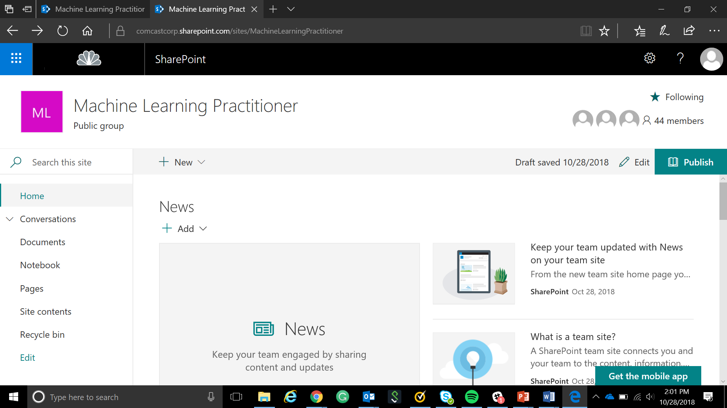
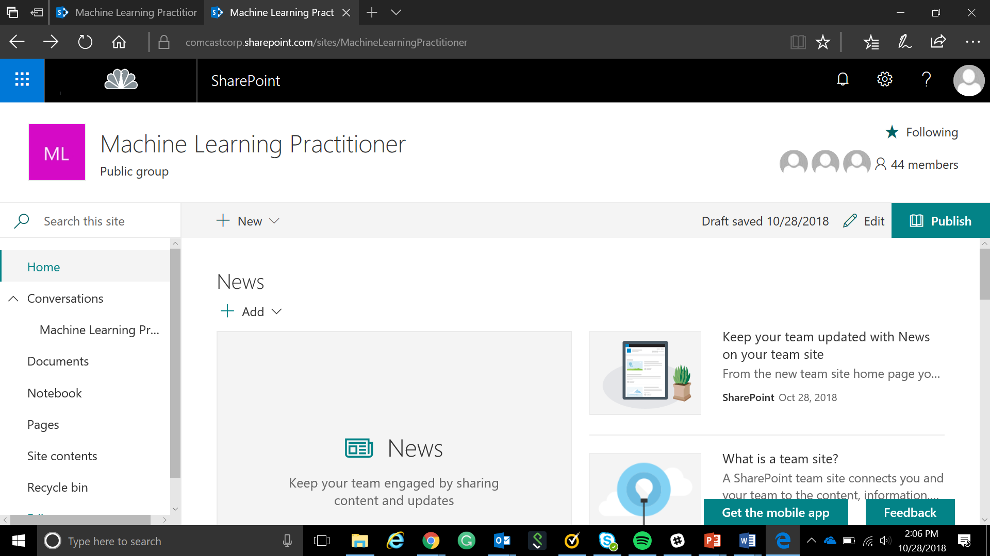
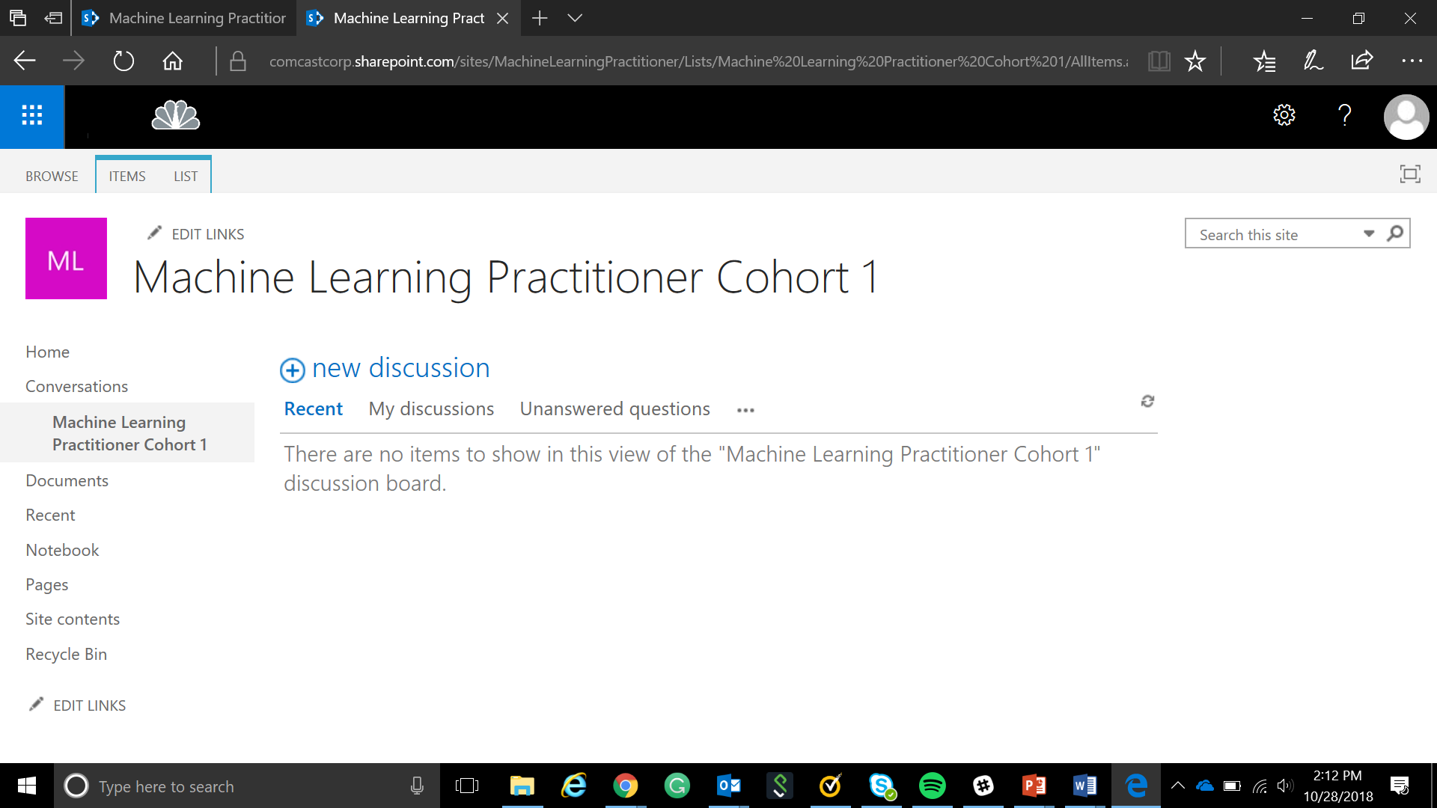
PAL to Participant Connections
https://comcastcorp.sharepoint.com/sites/MachineLearningPractitioner/Lists/Machine%20Learning%20Practitioner%20Cohort%201/AllItems.aspx

Slide 28

Peer Assisted Learning (PAL) Program
Selecting PALs
PALs play a very important role not only in the analysts experience, but also the success of Machine Learning Practitioner program as a whole, so it's vital the right people are chosen to fill this role. We have structured the program so that PALs will also benefit and grow professionally as a result of their time in the program
Potential PAL candidates can be identified in one of two ways:
Leader selection
Self-nomination
Basic Selection Criteria (Minimum)
Software Engineer in role 12+ months and in good standing
Demonstrated proficiency in understanding and applying machine learning concepts
Demonstrated proficiency with interpersonal skills such as building trust and rapport, effective communication, and coaching.
Advanced Selection Criteria (Preferred)
Software engineers who have prior mentoring, training, or teaching experience
Software engineers performing this role as a means of professional development or advancement

